Slide 1
Hepatology ATP

Slide 2
Unit Overview
Nottingham University Hospitals NHS Trust (NUH) is one of the UK’s largest acute trusts
Services are split over two sites with hepatology mostly based at the Queen’s Medical Centre (QMC)
We are a team of 10 consultant hepatologists working alongside a team of specialist nurses, dietitians and pharmacists
We have close links with colleagues in gastroenterology, HPB surgery, radiology, histology and oncology

Slide 3
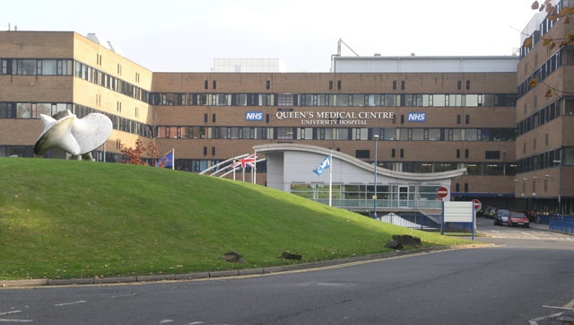
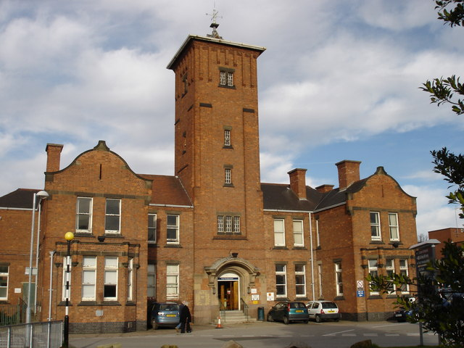
Nottingham City Hospital
Queen’s Medical Centre

Slide 4
Services
Inpatient and outpatient general hepatology
Transplant follow up and assessment clinics
Viral hepatitis clinic – NUH hosts the regional ODN
Dedicated HCC clinic to offer treatments including TACE, ablation and SABR
Advanced HPB endoscopy with daily ERCP/EUS lists
TIPSS and excellent links with interventional radiology colleagues
Close working with HPB surgery – NUH is the regional centre for HPB cancer surgery
Weekly advanced care planning MDT to provide high quality care to some of our sickest patients
Alcohol care team with daily input to the inpatient service
We are a highly research active department with close ties to the BRC based in the University of Nottingham
Specialist care for Wilson’s disease and NET
https://www.nuh.nhs.uk/liver-service-hepatology/

Slide 5
The Rotation
6 months Nottingham
6 months Cambridge
During your time in Nottingham we can tailor your training to meet your interests and PDP
There are opportunities to learn advanced skills in sub-speciality hepatology including HPB cancer
There are opportunities to gain skills in advanced HPB endoscopy

Slide 6
Example Weekly Duties
 | Monday | Tuesday | Wednesday | Thursday | Friday
Morning | Ward round | Ward round ACP MDT | Ward round Liver biopsy ERCP HCC clinic | Ward round Viral hepatitis clinic IMT teaching | Journal Club HBP MDT
Afternoon | Audit/Research | Histopathology meeting Varices endoscopy list Transplant Clinic (monthly) | Liver clinic | Pancreato-biliary clinic | Audit/Research Weekend prep ward round Varices endoscopy list

Slide 7
On Call
The ATP doctor will contribute to the speciality on call rota both in hours and out of hours including
Cover for gastroenterology and hepatology admissions
Acute GI bleed endoscopy
Support for the Hospital at Night team for gastroenterology and hepatology inpatients
There is daily support from our specialist nursing team
No GIM on call commitment

Slide 8
Regular Educational Meetings
Weekly journal club and case presentation
Weekly histology MDT
Weekly ward junior doctor teaching
Monthly clinical governance and M&M meeting

Slide 9
Useful Contacts
Hepatology ATP Link
Dr Peter Eddowes
Peter.eddowes2@nuh.nhs.uk
Deputy Divisional Director and Hepatology Lead
Dr Emilie Wilkes
Emilie.wilkes@nuh.nhs.uk
Head of Service for Gastroenterology
Dr Tim Card
Tim.card@nuh.nhs.uk

Slide 10
We look forward to welcoming you to Nottingham

